Slide 1
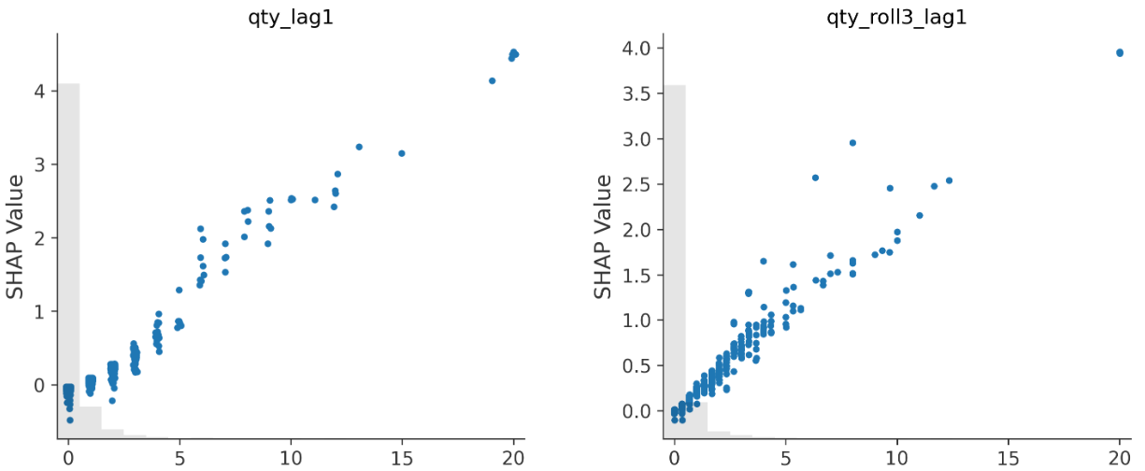
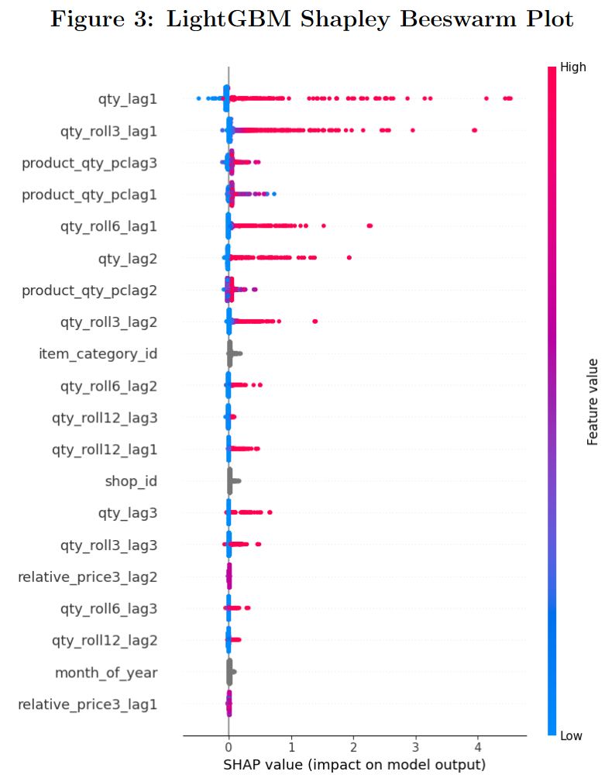
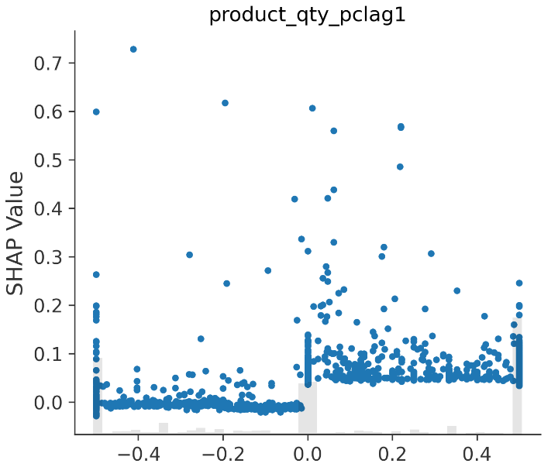
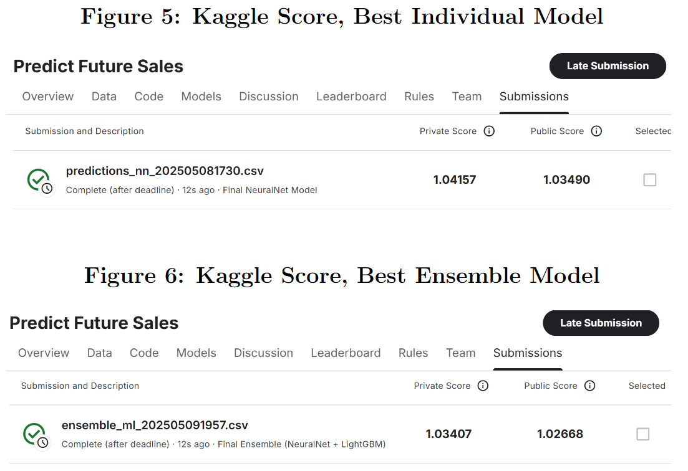
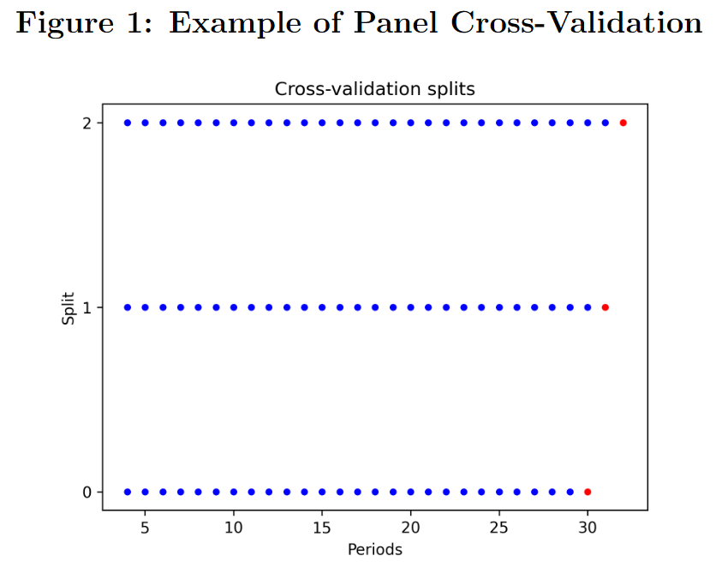
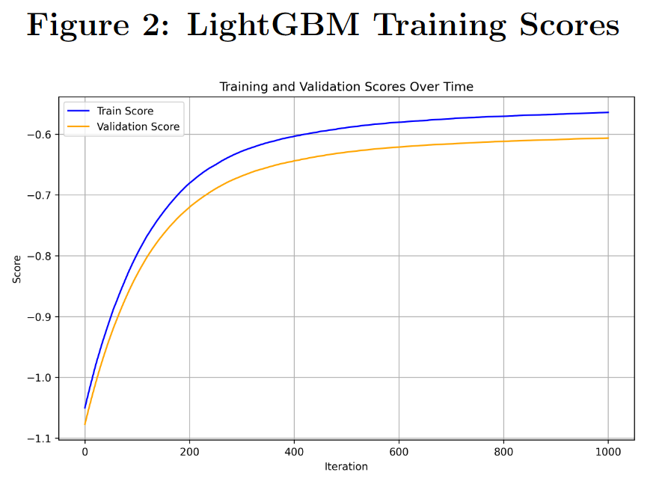
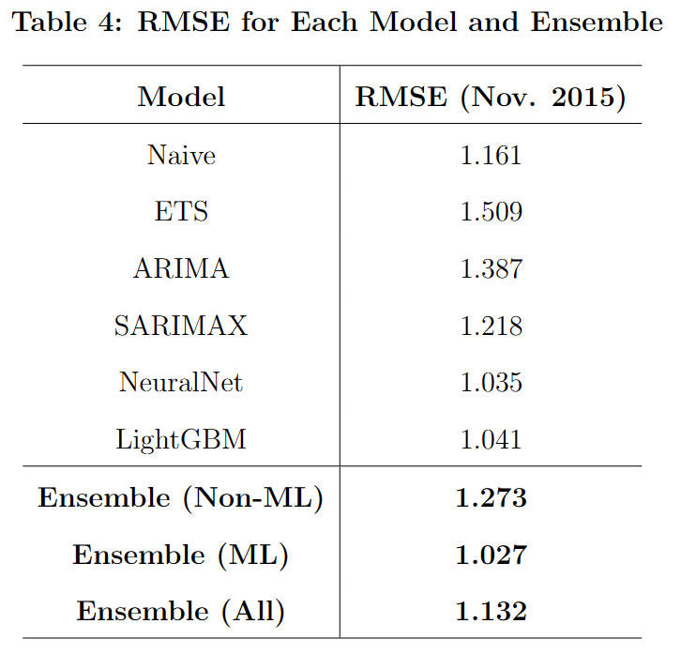

Forecasting Future Sales: A Comparison of Traditional and Modern Forecasting Techniques
Steven VanOmmeren Boston College
Abstract
I compete in Kaggle’s “Predict Future Sales” data competition, where the goal is to predict 1C Company’s sales for November 2015 using data from January 2013 to October 2015. The key challenge of this competition is that the predictions must be by store and product, requiring a total of 214,200 distinct predictions. I employ a variety of statistical techniques to approach this forecasting problem, comparing their strengths and weaknesses. I find that machine learning methods (NeuralNet and LightGBM) outperform traditional forecasting methods in this prediction problem.
Methods
Data
Because the daily data is quite large (and would be extremely large if balanced at the daily level), I aggregate it to the shop-product-monthly level. I also balance the panel and fill in months with no sales.
Training data has 6,426,000 observations, 91.2% of which have 0 sales!
Machine learning models are run on the full data, but the traditional forecasting models are performed on smaller datasets:
at the shop-month level (1470 observations)
at the product category-month level (2170 observations)
Feature Engineering
I create control variables through a combination of:
Lagged values
Moving averages
Economic variables: relative price, substitute/complement products, and substitute shops
Dummy variables (item category, shop, and month of year, separately)
Models Tested
Naïve
Exponential smoothing
ARIMA/SARIMAX
NeuralNet with 1 hidden layer
LightGBM
Various Ensembles of the above models
For the traditional methods, we cannot estimate 214,200 separate models.
Instead, run models for each shop and each product category, then combine the predictions to forecast future sales
For the machine learning methods:
Both models were trained with 2-fold panel cross-validation (CV)
167 total input parameters for each model
NeuralNet used a PCA step to reduce the variable count and orthogonalize the variables.
LightGBM model was hyperparameter tuned:
1st round: randomized grid search over 5 settings with panel CV
2nd round: search more thoroughly for a better learning rate while holding other settings fixed.
Finally, to evaluate model fit (besides submitting to Kaggle), I calculated and explored Shapley values for the LightGBM model.
Results
Shapley plots for the LightGBM model show that high values of “qty_lag1” (last month’s moving average sales) and “qty_roll3_lag1” (last month’s 3-month moving average sales) can have the largest impact on the predicted sales. Other variables like the relative price seem to have less effect on the predicted sales.
The lagged and moving-average sales variables have a generally positive and linear relationship with predicted sales. The “product_qty_pclag1” variable (percent change in average sales for the product) appears to have a step-function effect on sales, in which negative values have no effect, while any positive value has about the same (positive) effect.
Discussion
The best predictive model was an Ensemble of NeuralNet and LightGBM models. NeuralNet slightly outperformed LightGBM. The machine learning models noticeably outperformed the traditional forecasting techniques, and ETS and ARIMA models performed worse than a Naive prediction. To be fair to the traditional forecasting techniques, I did not attempt to fit 214,200 individual models to provide a fairer comparison to the machine learning models.
Overall, my best estimate represents a 12% improvement in RMSE compared to a Naïve forecast. Even the best score in the world for this competition is only a 36% improvement vs a Naive forecast, which exemplifies the complicated nature of this forecasting problem.
To improve my model, I would perform more extensive feature engineering. The machine learning methods are highly dependent on hyperparameter tuning. More extensive tuning would very likely result in better forecasts.
Introduction & Significance
Forecasting sales is critical to any company. Accurate forecasts of future sales at the shop and product level would allow 1C Company to identify under- and over-performing products. They can then adjust marketing and pricing practices accordingly, for example by reducing prices of under-performing products to increase sales. Additionally, interpretable forecasting models would allow the company to understanding why sales are up or down. As explained below, while machine learning methods are traditionally described as “black box” methods, techniques exist to help understand the output's sensitivity to changes in input variables.
Coulombe et al. (2022) evaluate various methods for predicting macroeconomic and financial indicators. The authors go so far as to describe the nonlinear capabilities associated with machine learning techniques as a “game-changer” for predicting irregular events like housing bubble bursts. The authors also endorse the use of K-fold cross-validation as a method to tune hyperparameters.
Ke et al. (2017) introduce LightGBM, a gradient boosting tree-based machine learning model. LightGBM modifies XGBoost to implement approximation techniques that drastically increase the speed of computation. Because of its computational efficiency and generally very good predictive ability, LightGBM is a common choice for prediction competitions. In fact, most of the top performers in the Kaggle competition use LightGBM.
Wang et al. (2022) test a variety of machine learning models to predict corporate finance risk indicators, comparing existing machine learning methods with LightGBM. The authors test four models: K-nearest neighbors, decision trees, random forest, and LightGBM. Reviewing a variety of metrics, the authors find that LightGBM beats the other models in most of the tests, and they believe that it can be used to effectively predict the financing risk of enterprises going forward.
Conclusion
I was able to forecast Nov. 2015 sales quantities for 214,200 shop-product combinations with an RMSE of just over 1 unit. This represents a noticeable improvement over a Naive forecast. My best forecasting model was an ensemble of a neural network with one hidden layer, and a LightGBM model. Traditional forecasting models failed to outperform a Naive prediction, though they were hindered by the scale of the dataset. Overall, much progress could be made through additional feature engineering, model iteration, and hyperparameter tuning, most of which would require substantially more computational resources.
References
Coulombe, Philippe Goulet et al. (Aug. 2022). “How is machine learning useful for macroeconomic forecasting?”
Hyndman, Rob and G. Athanasopoulos (2021). Forecasting: Principles and Practice.
Ke, Guolin et al. (2017). “Lightgbm: A highly efficient gradient boosting decision tree”
Wang, Di-ni, Lang Li, and Da Zhao (2022). “Corporate finance risk prediction based on LightGBM”

